Slide 1
MyFitnessPal – Redesigned Homepage

Slide 2
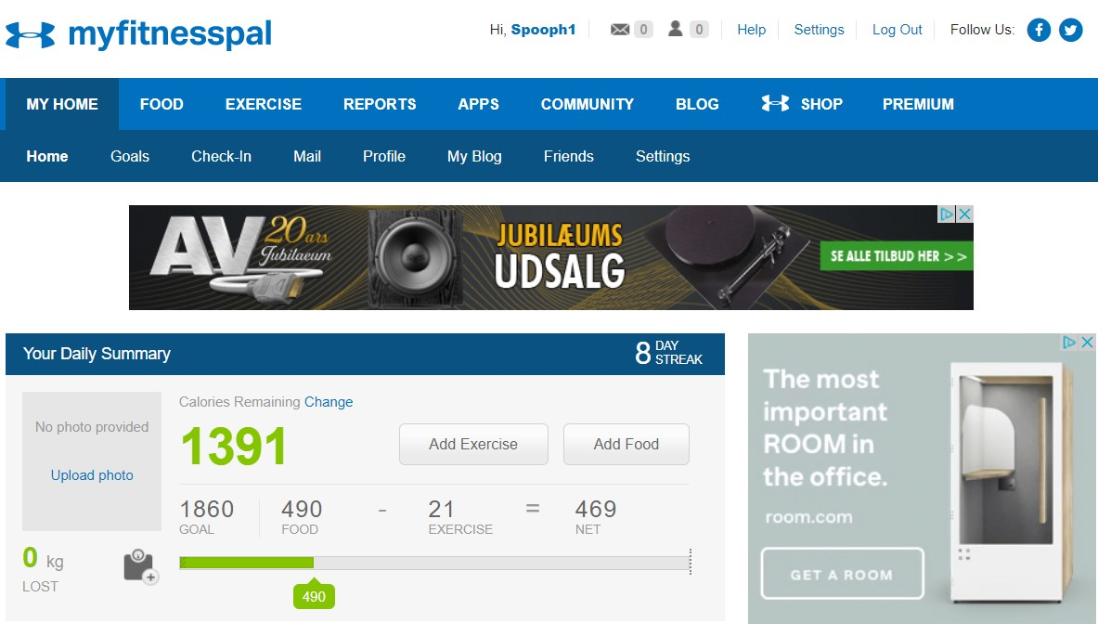
The two main problems with the home page is:
It gives the users a very small amount of information, so it forces the users to spent a lot of time going through the menus to get the information
The menus are confusing, and the buttons are poorly designed, so they are easy to overlook

Slide 3
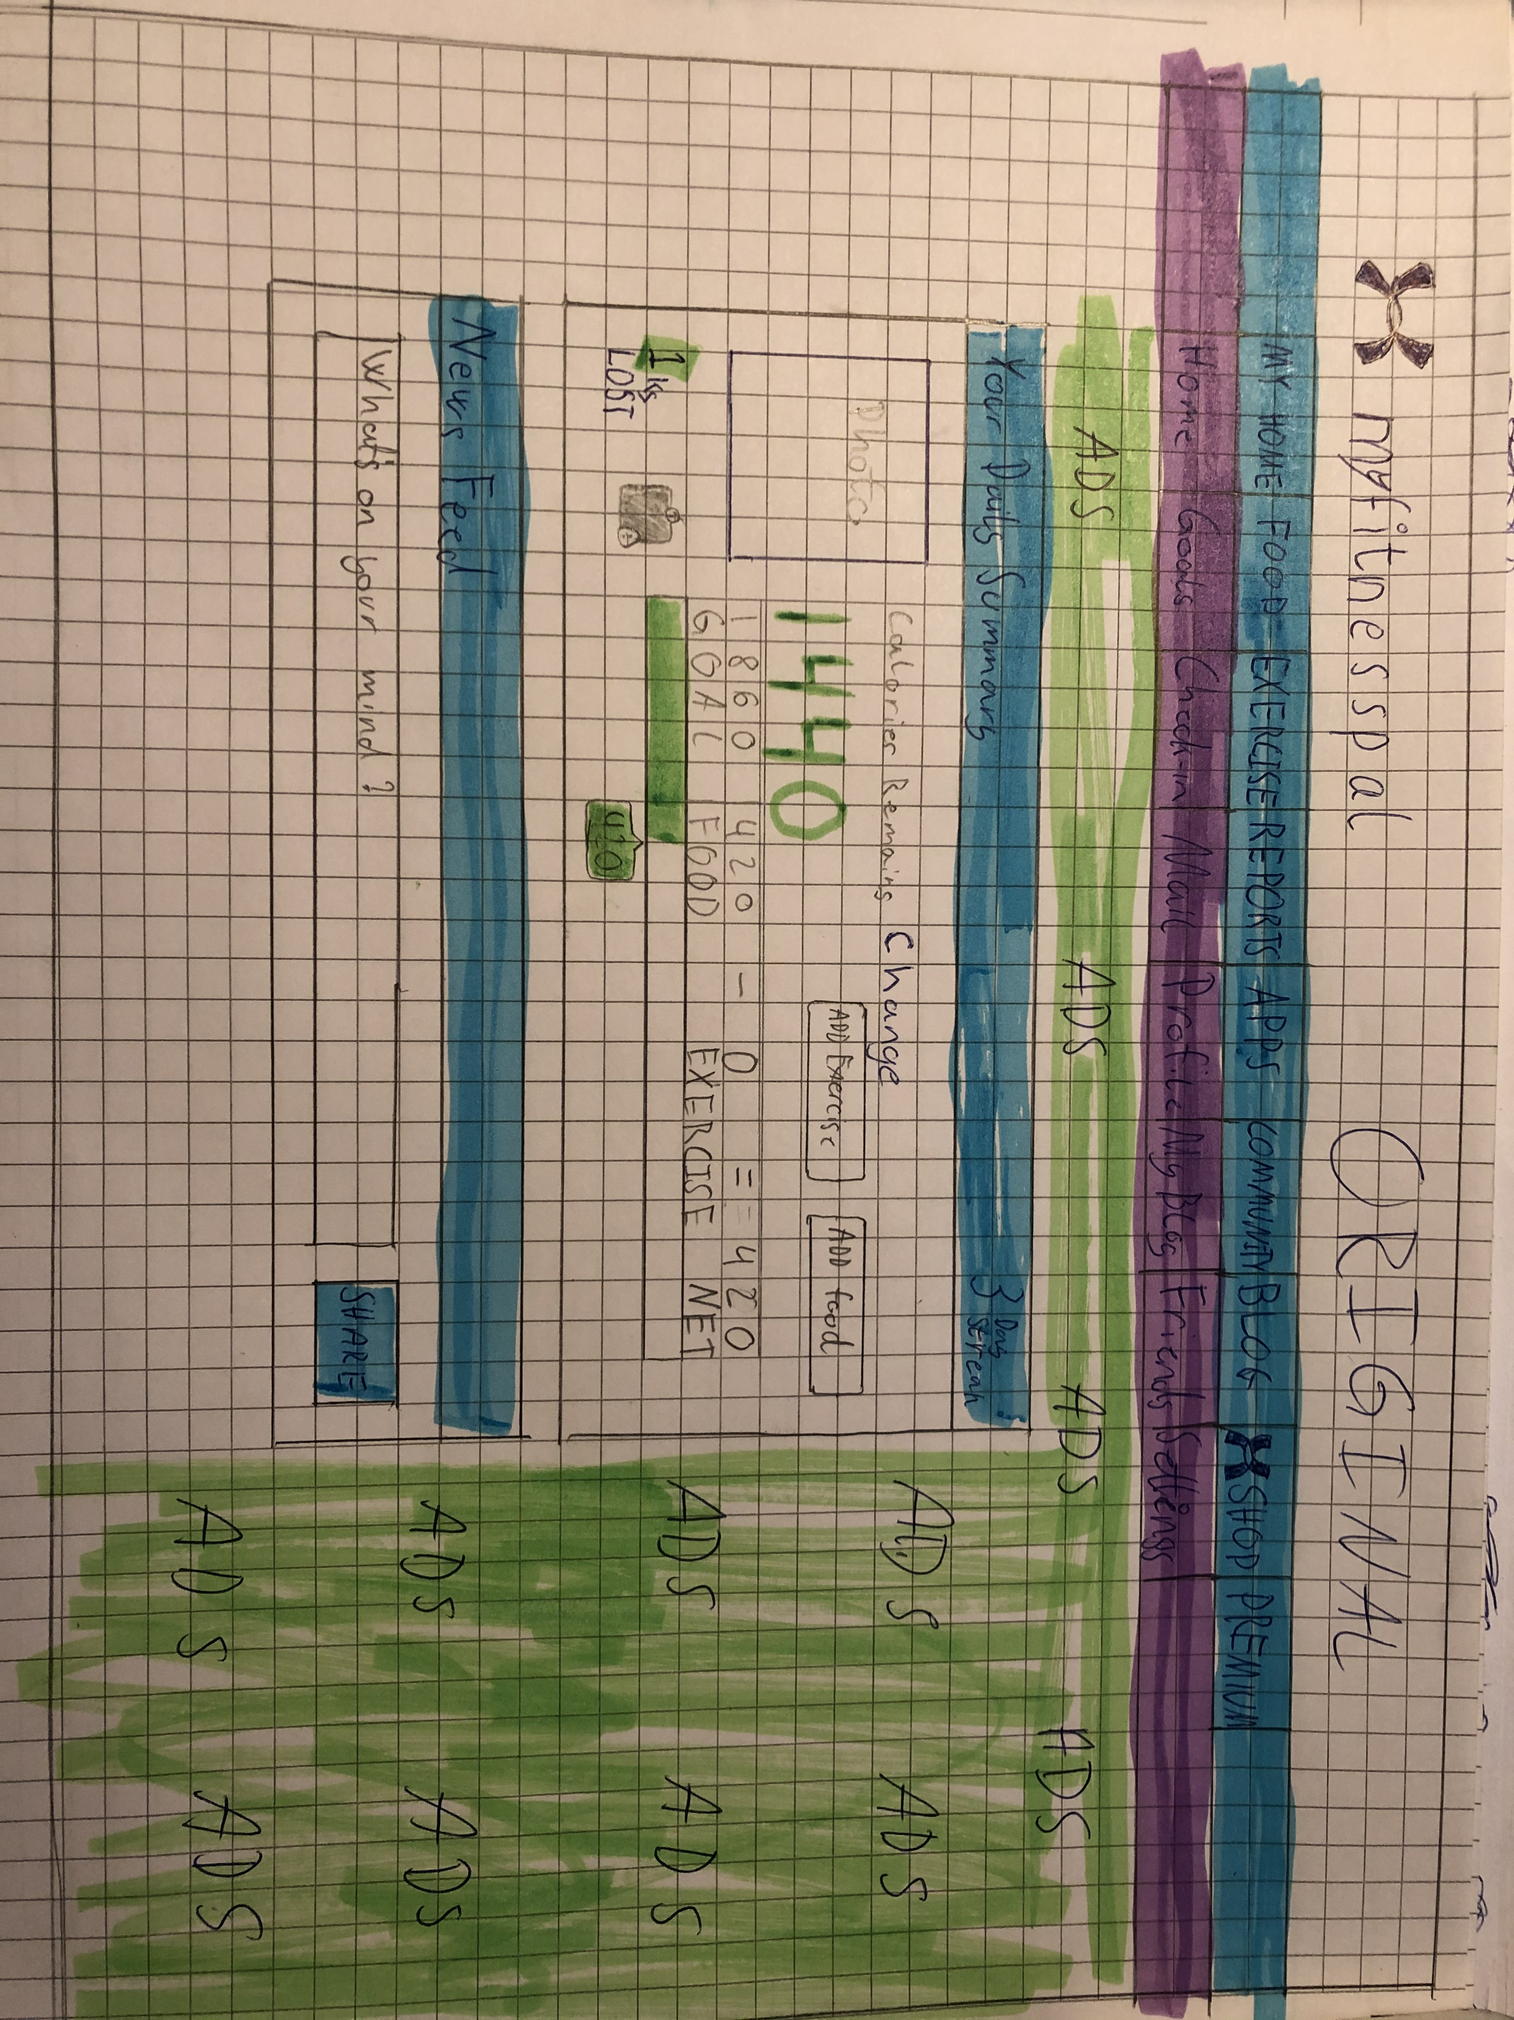
This is a lo-fi sketch of the original homepage.
I wanted to make the menu less confusing, while making it possible to do the maintasks without having to use the menues.
To achive this, I had to give the user more information on the homepage, and make the buttons easier to spot

Slide 4
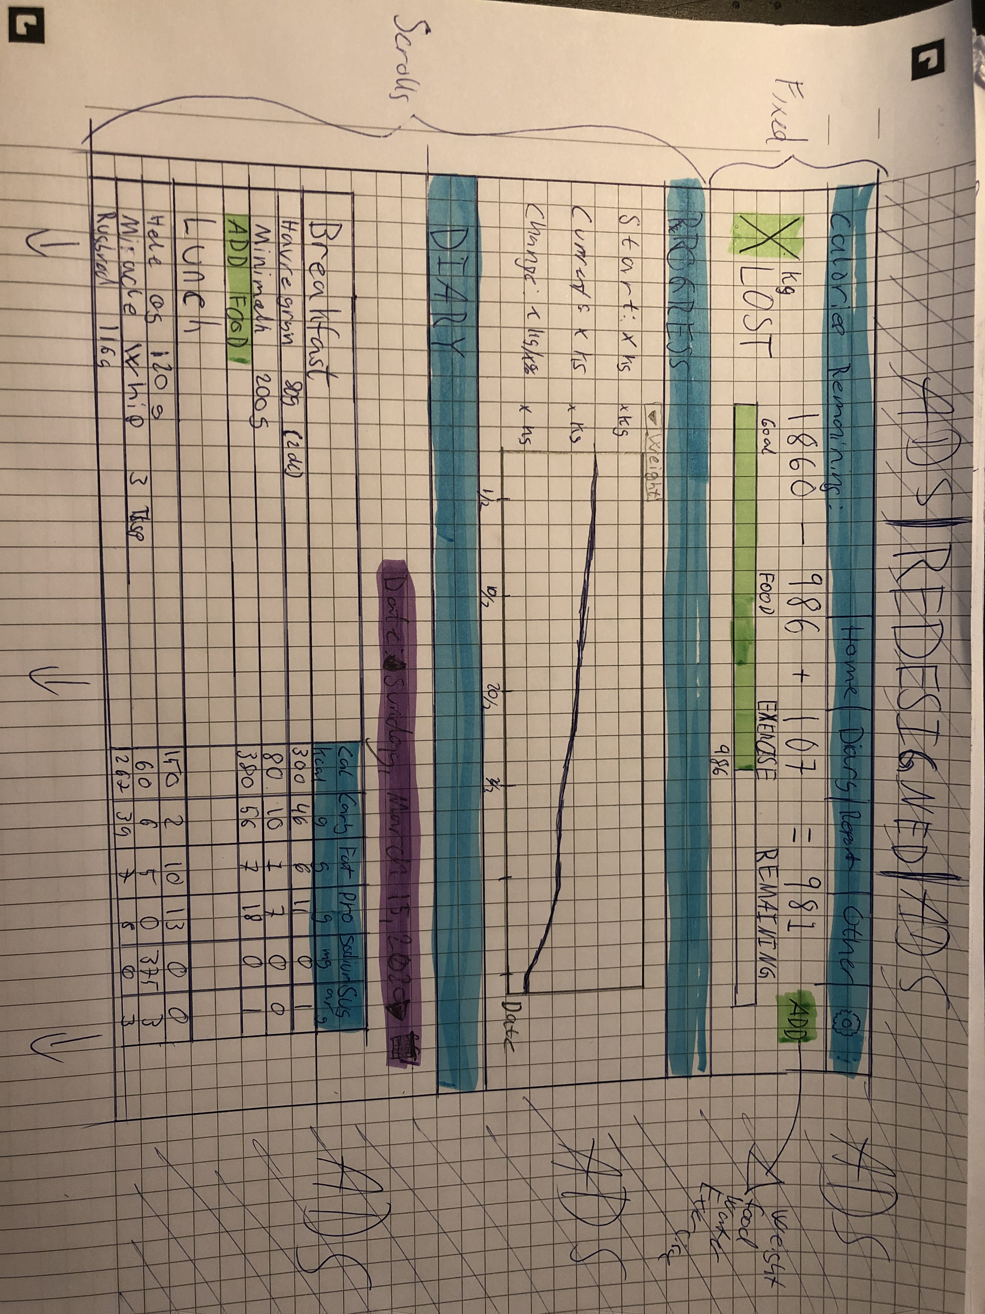
So this is what I came up with:
I kept the information about the daily calories-calculation, because this is what most people will use. In that box I’ve also made a button “ADD” which is used to add food, weight, water, ect.
Then I’ve made it possible for the user to watch their progress, which I hope will make them more motivated to continue.
Lastly, I’ve made the diary visibly on the homepage, so it’s easy to add the food

Slide 5
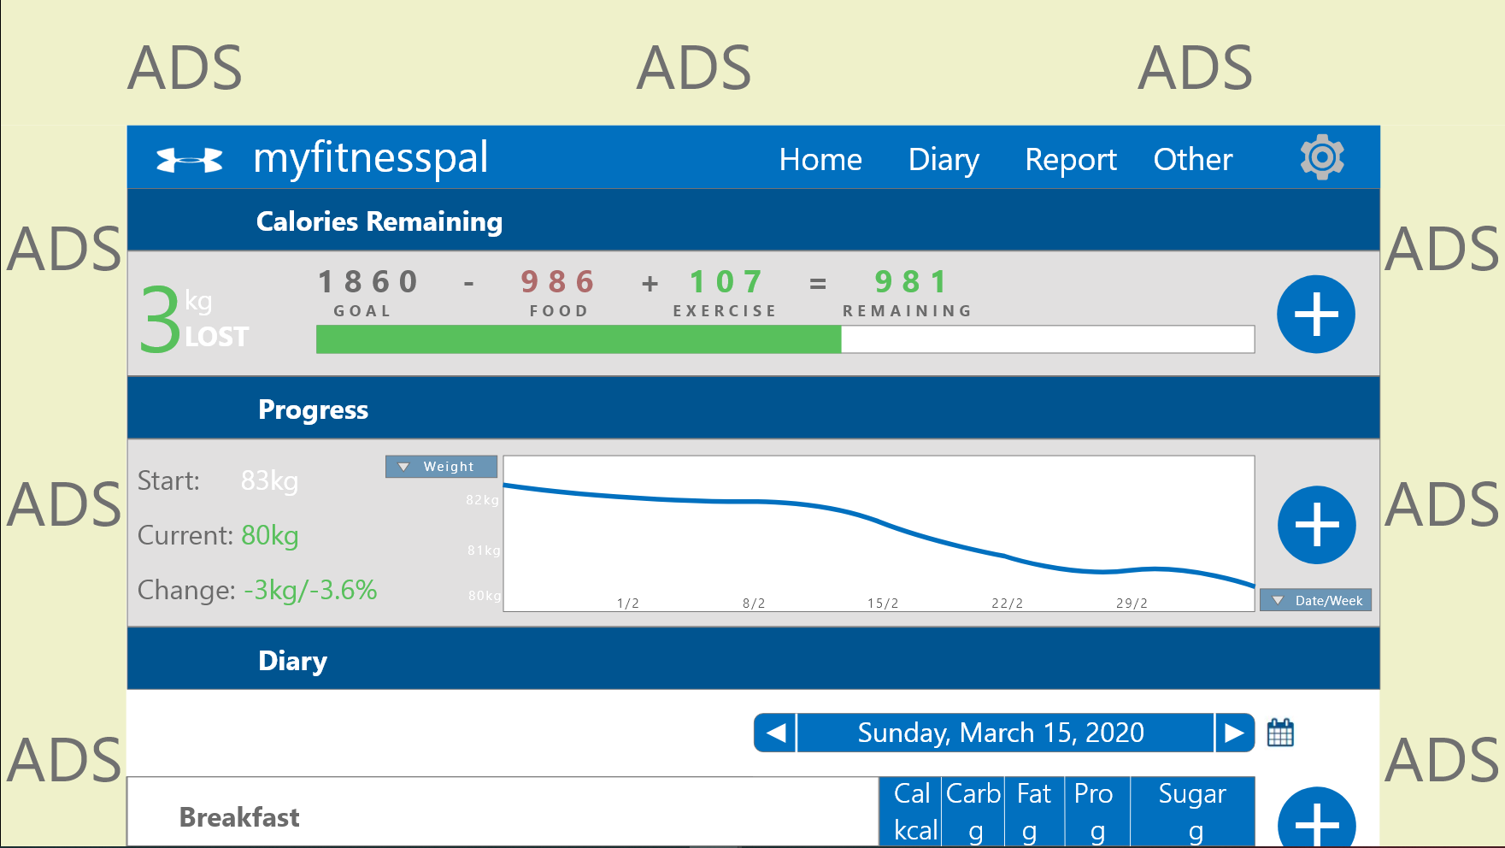
And this is how it looks in XD.
I decided to make the “ADD” button appear in each section, because I thought it would make more sense to the user.
Otherwise it’s mostly identical to the lo-fi prototype. The “diary-table” continues beneath the page, but because it takes forever and a day to make a table in XD, it’s very basic in the hi-fi prototype.

